Slide 1
Course Code:CSC402A Course Title: Web Architecture and Application Development
Course Leader:
Kishore S.M.
kishore.cs.et@msruas.ac.in

Slide 2
Objectives
After completing this lecture, the student will be able to
Analyze Hierarchical architecture

Slide 3
Contents
Hierarchical architecture
Master slave architecture
Virtual machine

Slide 4
Hierarchical Architectures
The hierarchical software architecture is characterized by viewing the entire system as a hierarchy structure
The software system is decomposed into logical modules (subsystems) at different levels in the hierarchy
Modules at different levels are connected by explicit or implicit method invocations
System software is typically designed using the hierarchical architecture style; examples include Microsoft .NET, Unix operating system, TCP/IP, etc
There are four particular styles that are hierarchical: the main-subroutine, master-server, layered, and virtual machine

Slide 5
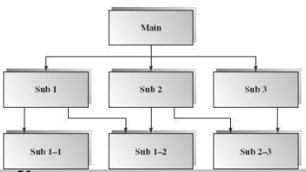
Hierarchical Architectures
Main-Subroutine
The purpose of this architecture style is to reuse the subroutines and have individual subroutines developed independently
Using this style, a software system is decomposed into subroutines hierarchically refined according to the desired functionality of the system

Slide 6
Hierarchical Architectures
Data is passed as parameters to subroutines from callers. Two ways to pass on parameter data are:
• Pass by reference where the subroutine may change the value of data referenced by the parameter
• Pass by value where the subroutine only uses the passed data but cannot change it.
Typically a “main” program drives the control over the sequencing of the subroutine calls by at least once looping over the invocations in some order

Slide 7
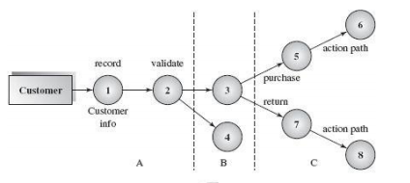
Hierarchical Architectures
Simple example of a purchase process requirement

Slide 8
Hierarchical Architectures
Benefits:
• It is easy to decompose the system based on the definition of the tasks in a top-down refinement manner
• This architecture can still be used in a subsystem of OO design
Limitations:
• Globally shared data in classical main-subroutines introduces vulnerabilities
• Tight coupling may cause more ripple effects of changes as compared to OO design

Slide 9
Hierarchical Architectures
Master-Slave
The master-slave architecture is a variant of the main-subroutine architecture style that supports fault tolerance and system reliability
In this architecture, slaves provide replicated services to the master, and the master selects a particular result among slaves by certain selection strategies
The slaves may perform the same functional task by different algorithms and methods or by a totally different functionality

Slide 10
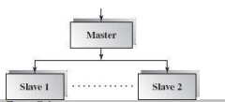
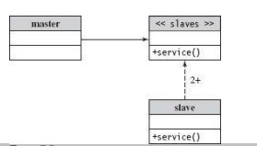
Hierarchical Architectures
Block Diagram and Class Diagram for master-slave architecture

Slide 11
Hierarchical Architectures
Other characteristics of this architecture include parallel computing and accuracy of computation. All slaves can be executed in parallel.
Since the same task is delegated to several different implementations, inaccurate results can be ruled out easily with a majority vote strategy or other algorithms.
Applicable domains of master-slave architecture:
Master-slave architecture is used for the software system where reliability is critical.

Slide 12
Hierarchical Architectures
Layered Architecture
In a layered architecture the system is decomposed into a number of higher and lower layers in a hierarchy
Each layer consists of a group of related classes that are encapsulated in a package
Each layer has its own sole responsibility in the system

Slide 13
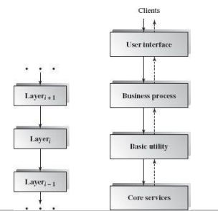
Hierarchical Architectures
Layered Architecture: Business Example
The solid lines indicate the service request direction path, while the dashed lines indicate the response path.

Slide 14
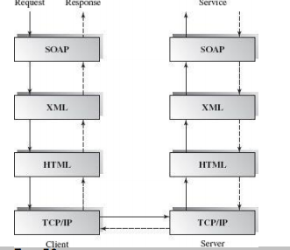
Hierarchical Architectures
Layered Architecture: SOAP Example
The SOAP based web services technology supports cross-platform remote object, request-response Internet computing.

Slide 15
Hierarchical Architectures
Applicable domains of layered architecture:
• Any system that can be divided between the application-specific portions and platform-specific portions which provide generic services to the application of the system
• Applications that have clean divisions between core services, critical services, user interface services, etc…
• Applications that have a number of classes that are closely related to each other so that they can be grouped together into a package to provide the services to others

Slide 16
Hierarchical Architectures
Benefits:
• Incremental software development based on increasing levels of abstraction
• Enhanced independence of upper layer to lower layer since there is no impact from the changes of lower layer services as long as their interfaces remain unchanged
• Enhanced flexibility: interchangeability and reusability are enhanced due to the separation of the standard interface and its implementation
• Component-based technology is a suitable technology to implement layered architecture; this makes it much easier for the system to allow for plug-and-play of new components

Slide 17
Hierarchical Architectures
Limitations:
• Lower runtime performance since a client's request or a response to a client must go through potentially several layers. There are also performance concerns of overhead on the data marshaling and buffering by each layer
• Many applications cannot fit this architecture design
• Breach of interlayer communication may cause deadlocks, and “bridging” may cause tight coupling
• Exceptions and error handling are issues in the layered architecture, since faults in one layer must propagate upward to all calling layers

Slide 18
Hierarchical Architectures
Virtual Machine
A virtual machine is built up on an existing system and provides a virtual abstraction, a set of attributes, and operations
In most cases a virtual machine separates a programming language or application environment from an execution platform
The common language runtime (CLR) of Microsoft .NET platform also plays the role of a virtual machine that uses a single intermediate language to unify several modules VB.NET, VC.NET, and C#

Slide 19
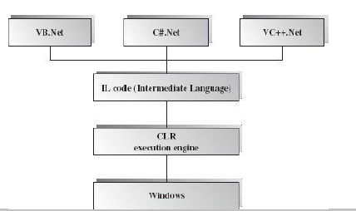
Hierarchical Architectures

Slide 20
Hierarchical Architectures
Applicable domain of virtual machine architecture:
• It is suitable for solving a problem by simulation or translation if there is no direct solution
• Sample applications include interpreters of microprogramming, XML processing, script command language execution, rule-based
system execution, Smalltalk and Java interpreter type programming languages
Benefits:
• Portability and machine platform independency
• Simplicity of software development
• Simulation for disaster working model

Slide 21
Hierarchical Architectures
Limitations:
• Slow execution of the interpreter due to the interpreter nature
• Additional overhead due to the new layer

Slide 22
Summary
The hierarchical software architecture is characterized by viewing the entire system as a hierarchy structure
In a layered architecture the system is decomposed into a number of higher and lower layers in a hierarchy
A virtual machine is built up on an existing system and provides a virtual abstraction, a set of attributes, and operations

